Slide 1

Parallel & Distributed Computing
Fault Tolerance in Distributed Systems
Farhad M. Riaz
Farhad.Muhammad@numl.edu.pk
Department of Computer Science
NUML, Islamabad

Slide 2
Fundamentals
What is fault?
  A fault is a blemish, weakness, or shortcoming of a particular hardware or software component.
  Fault, error and failures
Why fault tolerant?
  Availability, reliability, dependability, …
How to provide fault tolerance ?
  Replication
  Checkpointing and message logging
  Hybrid

Slide 3
Reliability
Reliability is an emerging and critical concern in traditional and new settings
  Transaction processing, mobile applications, cyberphysical systems
New enhanced technology makes devices vulnerable to errors due to high complexity and high integration
Technology scaling causes problems
  Exponential increase of soft error rate
Mobile/pervasive applications running close to humans
  E.g Failure of healthcare devices cause serious results
Redundancy techniques incur high overheads of power and performance
  TMR (Triple Modular Redundancy) may exceed 200% overheads without optimization [Nieuwland, 06]

Slide 4
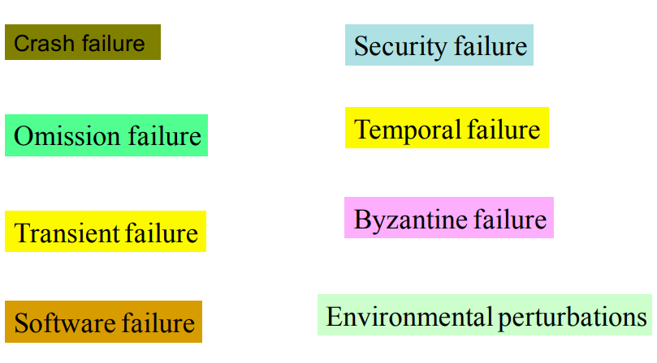
Classification of Failures

Slide 5
Crash Failures
Crash failure = the process halts. It is irreversible
In synchronous system, it is easy to detect crash failure (using heartbeat signals and timeout). But in asynchronous systems, it is never accurate, since it is not possible to distinguish between a process that has crashed, and a process that is running very slowly.
Some failures may be complex and nasty. Fail-stop failure is a simple abstraction that mimics crash failure when program execution becomes arbitrary. Implementations help detect which processor has failed. If a system cannot tolerate fail-stop failure, then it cannot tolerate crash

Slide 6
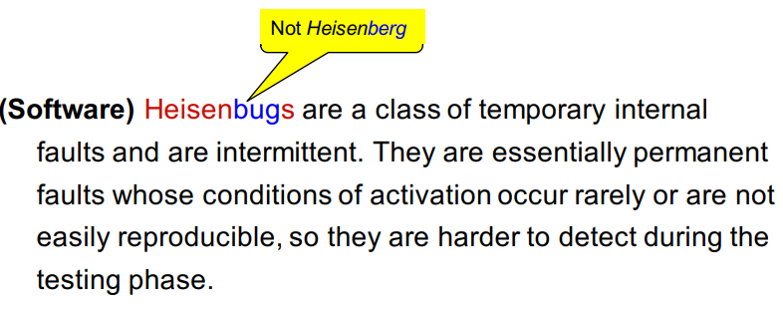
Transient Failure
(Hardware) Arbitrary perturbation of the global state. May be induced by power surge, weak batteries, lightning, radio frequency interferences, cosmic ray

Slide 7
Temporal Failures
Inability to meet deadlines
  Correct results are generated, but too late to be useful. Very important in real-time systems.
May be caused by poor algorithms, poor design strategy or loss of synchronization among the processor clocks

Slide 8
Byzantine Failure
Anything goes! Includes every conceivable form of erroneous behavior. The weakest type of failure
Numerous possible causes. Includes malicious behaviors (like a process executing a different program instead of the specified one) too.
Most difficult kind of failure to deal with.

Slide 9
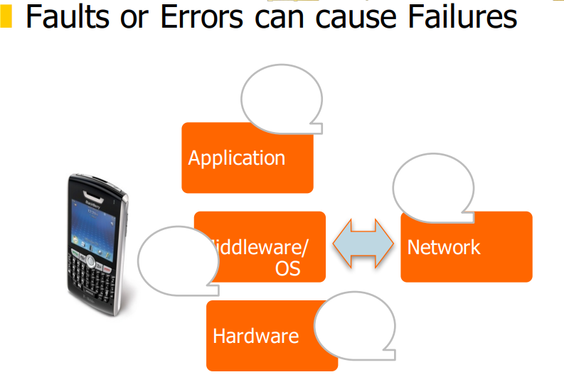
Errors/Failures across system layers

Slide 10
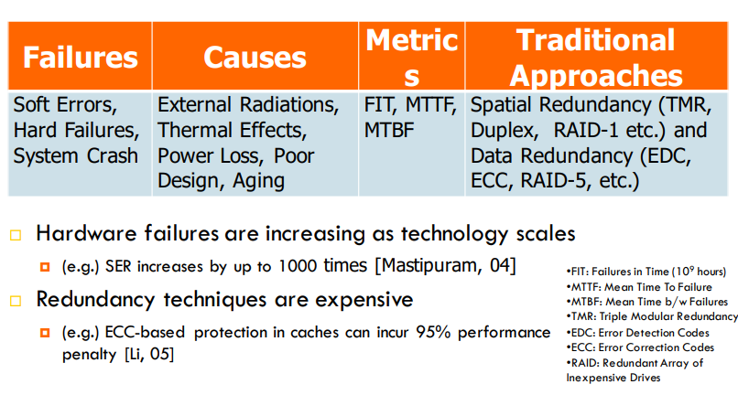
Hardware Errors and Error 11 Control Schemes

Slide 11
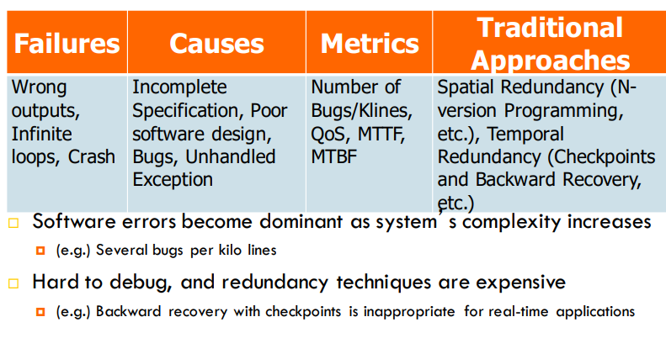
Software Errors and Error 14 Control Schemes

Slide 12
Software Failures
Coding error or human error
  On September 23, 1999, NASA lost the $125 million Mars orbiter spacecraft because one engineering team used metric units while another used English units leading to a navigation fiasco, causing it to burn in the atmosphere.
Design flaws or inaccurate modeling
  Mars pathfinder mission landed flawlessly on the Martial surface on July 4, 1997. However, later its communication failed due to a design flaw in the real-time embedded software kernel VxWorks. The problem was later diagnosed to be caused due to priority inversion, when a medium priority task could preempt a high priority one.

Slide 13
Software Failures
Memory leak
  Processes fail to entirely free up the physical memory that has been allocated to them. This effectively reduces the size of the available physical memory over time. When this becomes smaller than the minimum memory needed to support an application, it crashes.

Slide 14
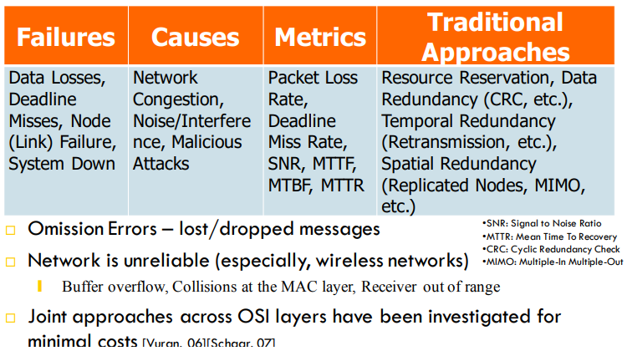
Network Errors and Error 17 Control Schemes

Slide 15
Classifying Fault-Tolerance
Masking tolerance.
  Application runs as it is. The failure does not have a visible impact. All properties (both liveness & safety) continue to hold.
  Non-masking tolerance.
    Safety property is temporarily affected, but not liveness.
  Example 1.
    Clocks lose synchronization, but recover soon thereafter.
  Example 2.
    Multiple processes temporarily enter their critical sections, but thereafter, the normal behavior is restored

Slide 16
Classifying Fault-Tolerance
Fail-safe tolerance
  Given safety predicate is preserved, but liveness may be affected
  Example.
    Due to failure, no process can enter its critical section for an indefinite period. In a traffic crossing, failure changes the traffic in both directions to red.
Graceful degradation
  Application continues, but in a “degraded ”mode. Much depends on what kind of degradation is acceptable.
  Example. Consider message-based mutual exclusion. Processes will enter their critical sections, but not in timestamp order

Slide 17
Conventional Approaches
Build redundancy into hardware/software
  Modular Redundancy, N-Version Programming Conventional TRM (Triple Modular Redundancy) can incur 200% overheads without optimization. ❘
  Replication of tasks and processes may result in overprovisioning
  Error Control Coding
Checkpointing and rollbacks
  Usually accomplished through logging (e.g. messages)
  Backward Recovery with Checkpoints cannot guarantee the completion time of a task.
Hybrid
  Recovery Blocks

Slide 18
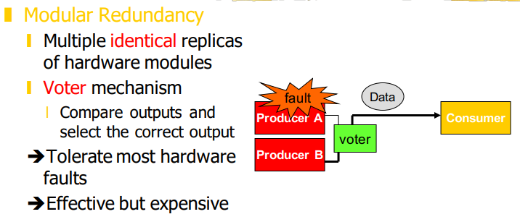
Modular Redundancy

Slide 19
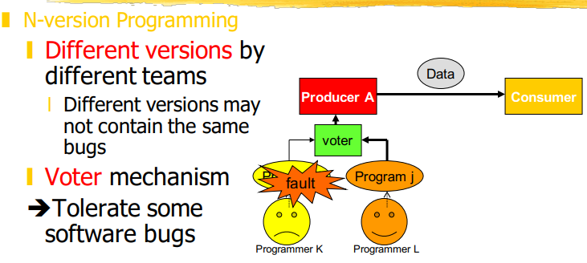
N-version Programming

Slide 20
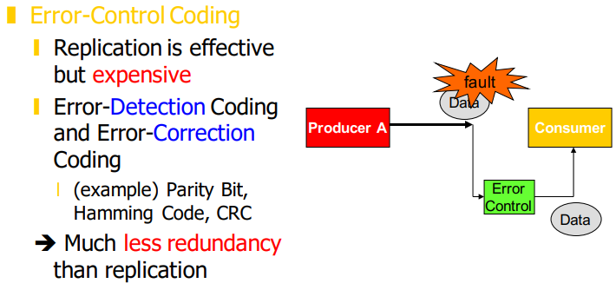
Error-Control Coding

Slide 21
Consensus
Reaching Agreement is a fundamental problem in distributed computing
Mutual Exclusion
  processes agree on which process can enter the critical section
Leader Election
  the processes agree on which is the elected process
Totally Ordered Multicast
  the processes agree on the order of message delivery
Commit or Abort in distributed transactions
  Reaching agreement about which process has failed
Other examples
  Air traffic control system: all aircrafts must have the same view
  Spaceship engine control – action from multiple control processes( “proceed” or “abort” )
  Two armies should decide consistently to attack or retreat

Slide 22
Defining Consensus
N processes
Each process p has
  input variable xp : initially either 0 or 1 1.
  output variable yp : initially b (b=undecided) – can be changed only once
Consensus problem:
  design a protocol so that either
    all non-faulty processes set their output variables to 0
    Or non-faulty all processes set their output variables to 1
    There is at least one initial state that leads to each outcomes 1 and 2 above

Slide 23
Solving Consensus
No failures -trivial
    All-to-all broadcast
    With failures
      Assumption: Processes fail only by crash-stopping
    Synchronous system:
      bounds on ❙ Message delays
      Max time for each process step
      e.g., multiprocessor (common clock across processors)
    Asynchronous system:
    no such bounds! e.g., The Internet! The Web!

Slide 24
Variant of Consensus Problem
Consensus Problem (C)
  Each process propose a value
  All processes agree on a single value
Byzantine General Problem (BG)
  Process fails arbitrarily, byzantine failure
  Still processes need to agree
Interactive Consistency (IC)
  Each process propose its value
  All processes agree on the vector

Slide 25
Consensus in Synchronous System
Possible
  With one or more faulty processes
Solution:
  Basic idea: all processes exchange (multicast) what other processes tell them in several rounds
Proof:
  to reach consensus with f failures, the algorithm needs to run in f + 1 rounds
  Basic idea: if A and B do not agree on value X, then some other process C, did send X to A, but not to B.
  Requires 1 failure in each round, so f+1 fails.
  Contradiction

Slide 26
Asynchronous Consensus
Messages have arbitrary delay, processes arbitrarily slow
Impossible to achieve!
  a slow process indistinguishable from a crashed process
Theorem:
  In a purely asynchronous distributed system, the consensus problem is impossible to solve if even a single process crashes
Result due to Fischer, Lynch, Patterson (commonly known as FLP 85).

Slide 27
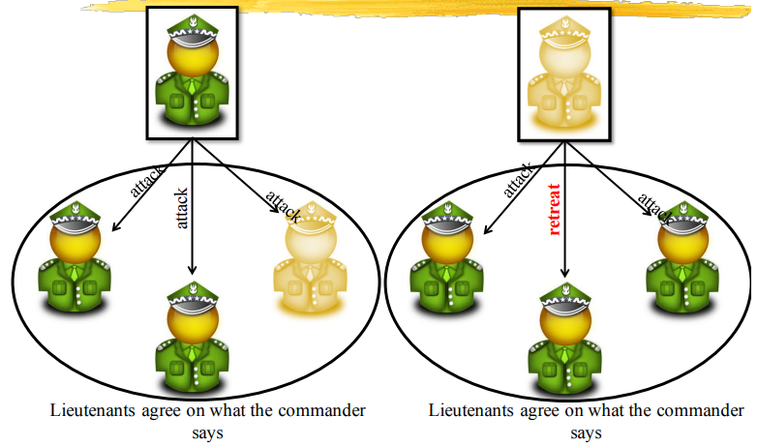
Byzantine General Problem

Slide 28
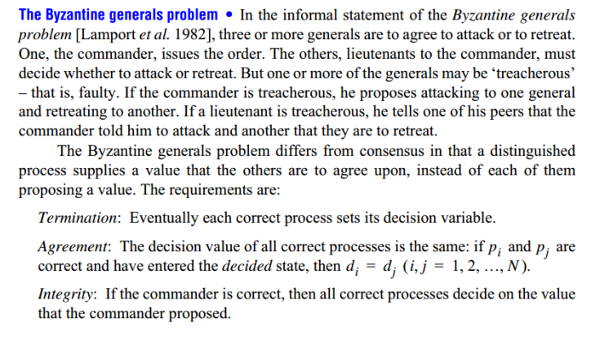
Byzantine General Problem

Slide 29
Failure Detection
The design of fault-tolerant algorithms will be simple if processes can detect failures.
In synchronous systems with bounded delay channels, crash failures can definitely be detected using timeouts.
In asynchronous distributed systems, the detection of crash failures is imperfect.
Completeness – Every crashed process is suspected
Accuracy – No correct process is suspected.

Slide 30
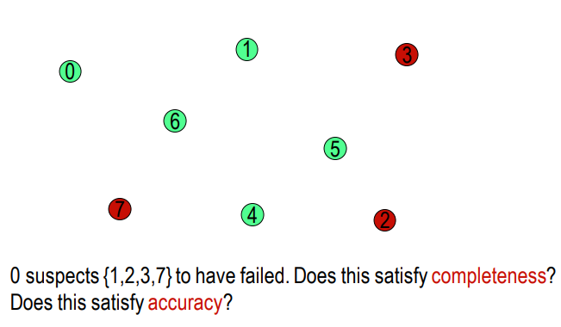
Example

Slide 31
Classification of Completeness
Strong completeness.
  Every crashed process is eventually suspected by every correct process, and remains a suspect thereafter.
Weak completeness.
  Every crashed process is eventually suspected by at least one correct process, and remains a suspect thereafter.
  Note that we don’t care what mechanism is used for suspecting a process

Slide 32
Classification of accuracy
Strong accuracy.
  No correct process is ever suspected.
Weak accuracy.
  There is at least one correct process that is never suspected.

Slide 33
Eventual Accuracy
A failure detector is eventually strongly accurate, if there exists a time T after which no correct process is suspected.
(Before that time, a correct process be added to and removed from the list of suspects any number of times)
A failure detector is eventually weakly accurate, if there exists a time T after which at least one process is no more suspected

Slide 34
Classifying Failure Detectors
Perfect P. (Strongly) Complete and strongly accurate
Strong S. (Strongly) Complete and weakly accurate
Eventually perfect ◊P. (Strongly) Complete and eventually strongly accurate
Eventually strong ◊S (Strongly) Complete and eventually weakly accurate
Other classes are feasible: W (weak completeness) and weak accuracy) and ◊W

Slide 35
Detection of Crash Failures
Failure can be detected using heartbeat messages (periodic “I am alive” broadcast) and timeout
  if processors speed has a known lower bound
  channel delays have a known upper bound

Slide 36
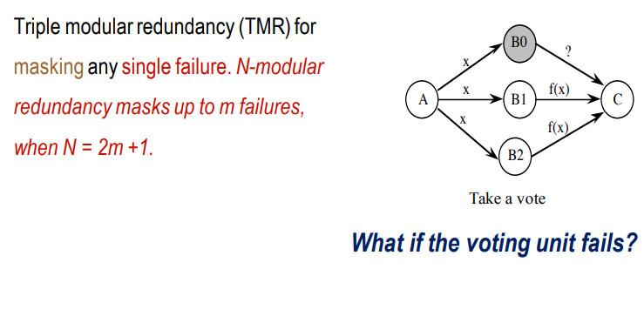
Tolerating Crash Failures

Slide 37
Detection of Omission Failures
For FIFO channels: Use sequence numbers with messages.
  (1, 2, 3, 5, 6 … ) ⇒ message 4 is missing
  Non-FIFO bounded delay channels- use timeout
  What about non-FIFO channels for which the upper bound of the delay is not known?
  Use unbounded sequence numbers and acknowledgments. But acknowledgments may be lost too!
  Let us look how a real protocol deals with omission …

Slide 38
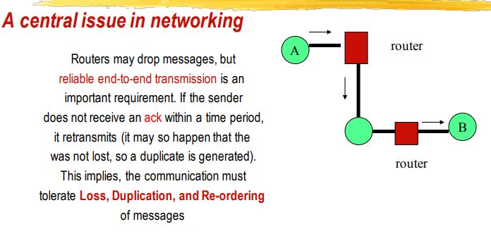
Tolerating Omission Failures

